Slide 1
Make PowerPoint Presentations with R Markdown
An Introduction

Slide 2
Why would you want to create a PowerPoint presentation from R Markdown?

Slide 3

Everyone knows PowerPoint
Standard communication tool
Especially in business
People “speak” PowerPoint
Bullet points
It’s useful – it works
Flexible enough to get the job done
You can make the slides fast or pretty
Everyone has personal experience with it
Some love it
Others hate it

Slide 4

Anyone can learn R Markdown
It is so easy!
And you can use R!
Visualizations, tables, code, etc.
Plain text
Versioned, reproducible, collaborative
Emits multiple output
HTML, PDF, Microsoft Word
but not PowerPoint … UNTIL NOW!

Slide 5
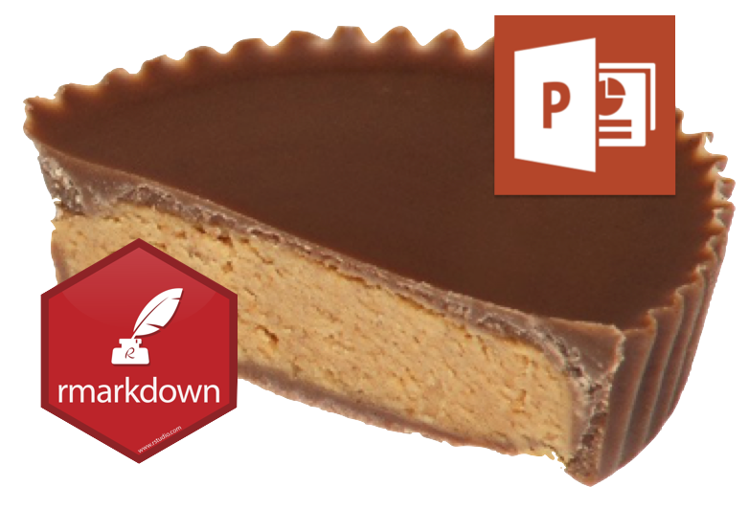
We are combining two great things
Think of it as the Rheese’s Peanut Butter Cup of presentations

Slide 6
Other options
These popular R packages offer fine grain functions for creating PowerPoint presentations.
ReportRs
OfficeR
R2PPT
Displayr

Slide 7
Demo: Create a PowerPoint Presentation with RStudio

Slide 8
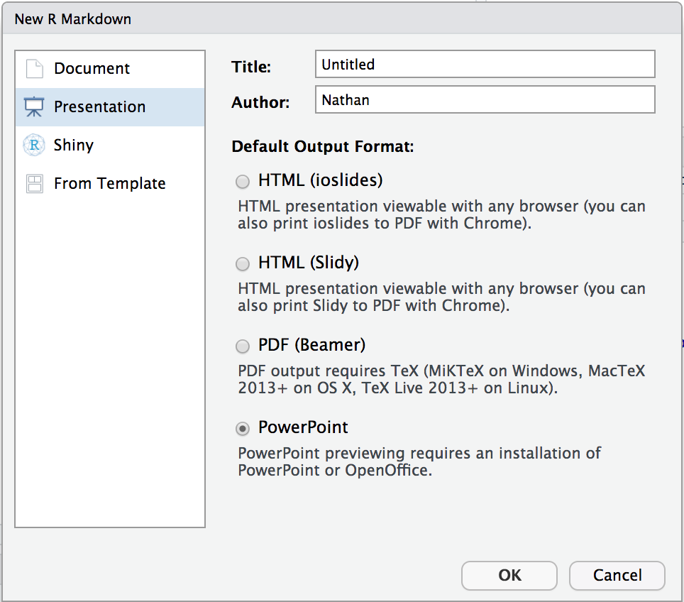
Quick Example
Create a new R Markdown Document:
File > New File > R Markdown > Presentation
Then choose:
Knit to PowerPoint
Open the presentation:
RStudio Desktop – Opens automatically
RStudio Server – Downloads automatically
You will need PowerPoint on your workstation
Render programmatically
IDE not required
rmarkdown::render("in.Rmd", output_format = "powerpoint_presentation")

Slide 9
How does it work?

Slide 10
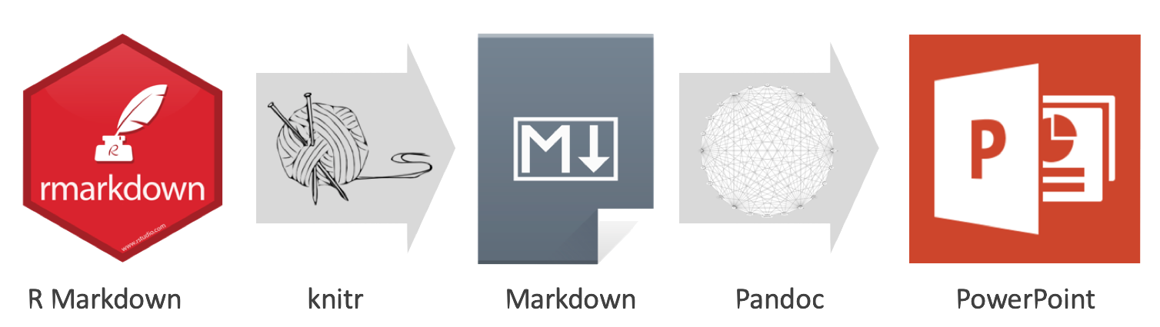
R Markdown > Markdown > PowerPoint

Slide 11

Pandoc
What is Pandoc?
Document converter (e.g. Markdown to HTML)
Free software Bundled in RStudio IDE
PowerPoint output added in Pandoc 2
Initial release in December 2017
Included in upcoming RStudio IDE v1.2
Included in RStudio Connect as of v1.6.4

Slide 12
Use Cases

Slide 13
1. Render presentation then customize
Output text, tables, and plots to PowerPoint
Modify and/or copy slides into your final presentation
Example

Slide 14
2. Programmatically render and distribute
Output entire presentations with R Markdown
Optional
Render programmatically
Paramaterize and automate
Share presentation (e.g. via email)
Example

Slide 15
Features

Slide 16
Markdown features
Most markdown elements
Text formats
Lists
Math expressions
Hyperlinks
As well as these nifty features
Images and tables with captions
Speaker notes
Templates
Example

Slide 17
Supports R Code (of course!)
Code syntax highlighting
Table output
Plots (e.g ggplot)
HTML Widgets
Example

Slide 18
Shiny
Point viewers to your Shiny app
Install webshot package
Install phanotmjs: webshot::install_phantomjs()
Call knitr::include_app()
A linked image of your app will be included in your presentation
Example

Slide 19
Resources

Slide 20

Where to get help
Getting started
R Markdown: The Definitive Guide
Troubleshooting
Submitting issues
Community

Slide 21

Frequently asked questions
Troubleshooting
Why does my PowerPoint presentation not open properly?
How do I put an image and text on the same slide?
How do I control the placement of images and text?
Getting started
How do I use custom templates?
How do I structure my presentation?

Slide 22

Vignettes
github.com/sol-eng/powerpoint
Getting Started
Markdown Features
Images and Tables
Columns and Notes
Templates
Structuring the Presentation
R Code Chunks

Slide 23
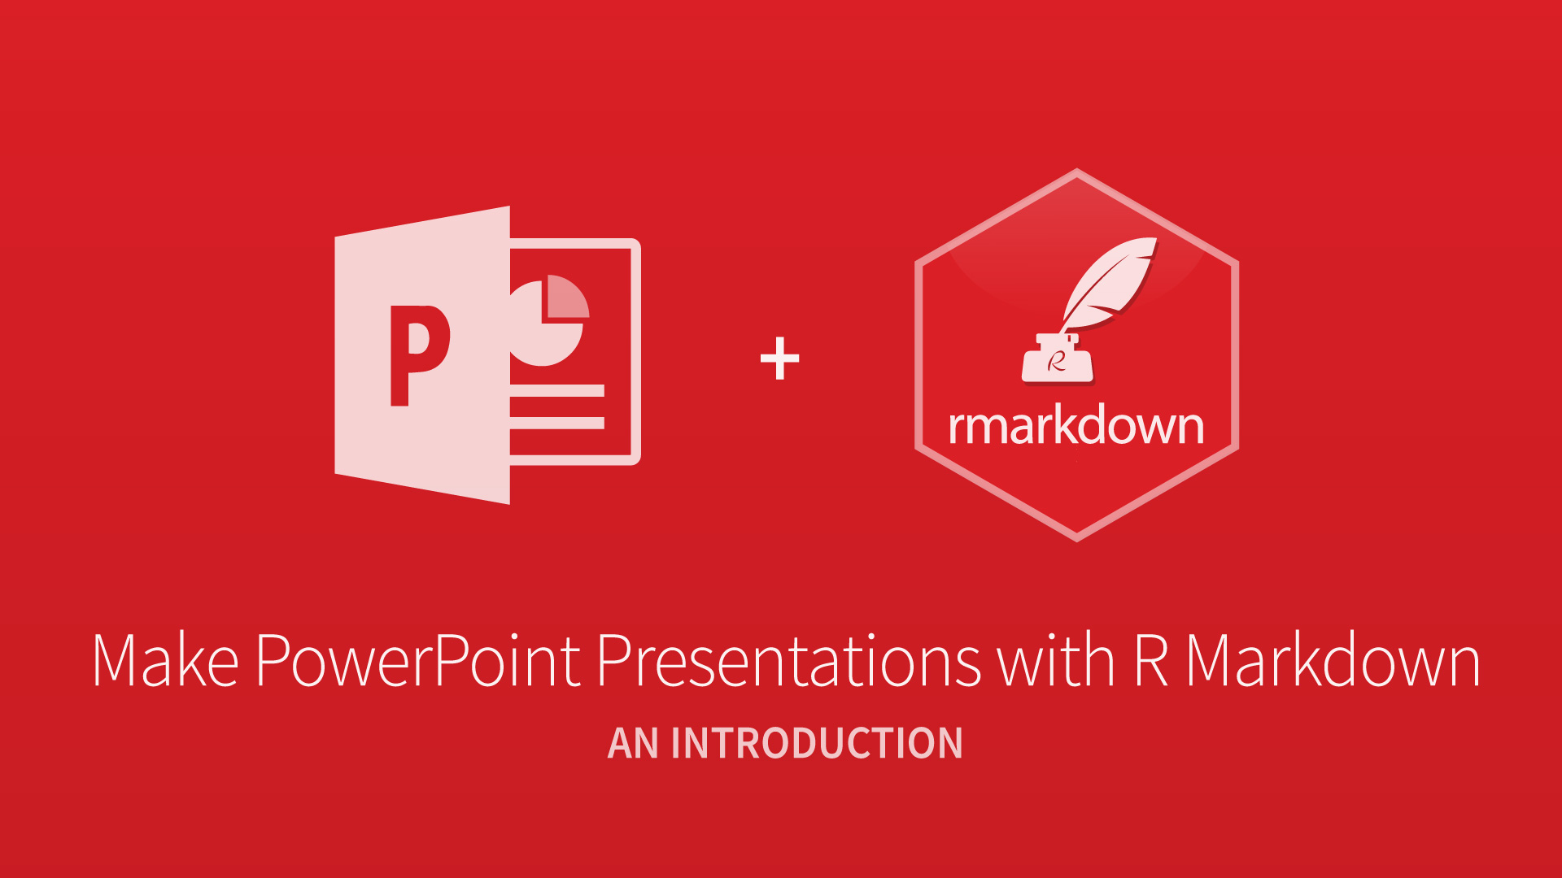
End

